Slide 1
Deep Learning in Production
Adam Gibson: Skymind
@agibsonccc

Slide 2
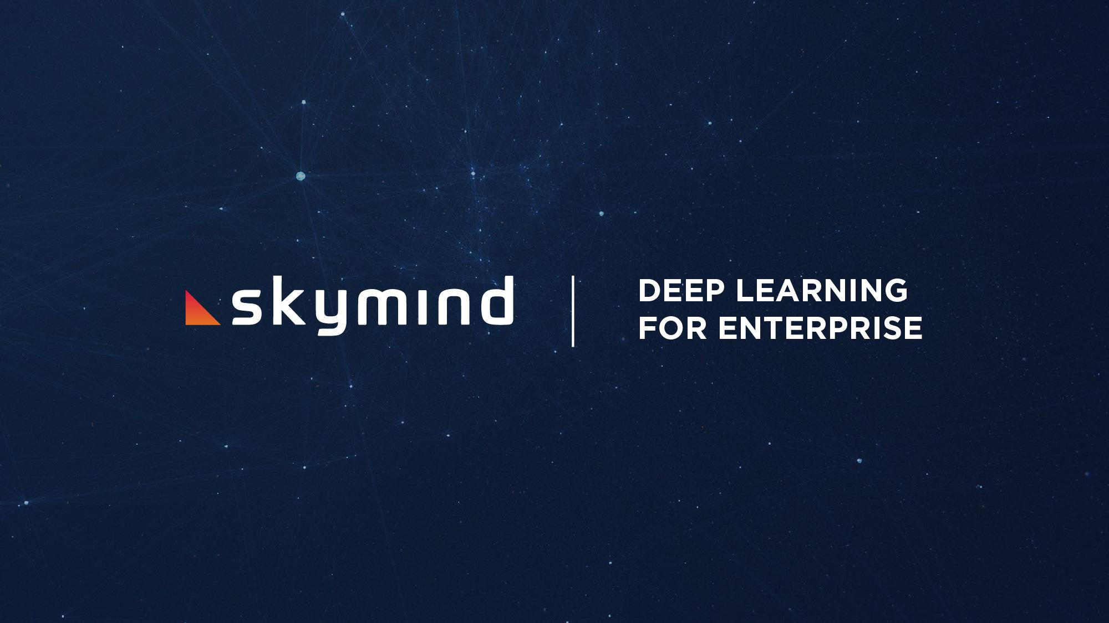
ADAM GIBSON | adam@skymind.io

Slide 3
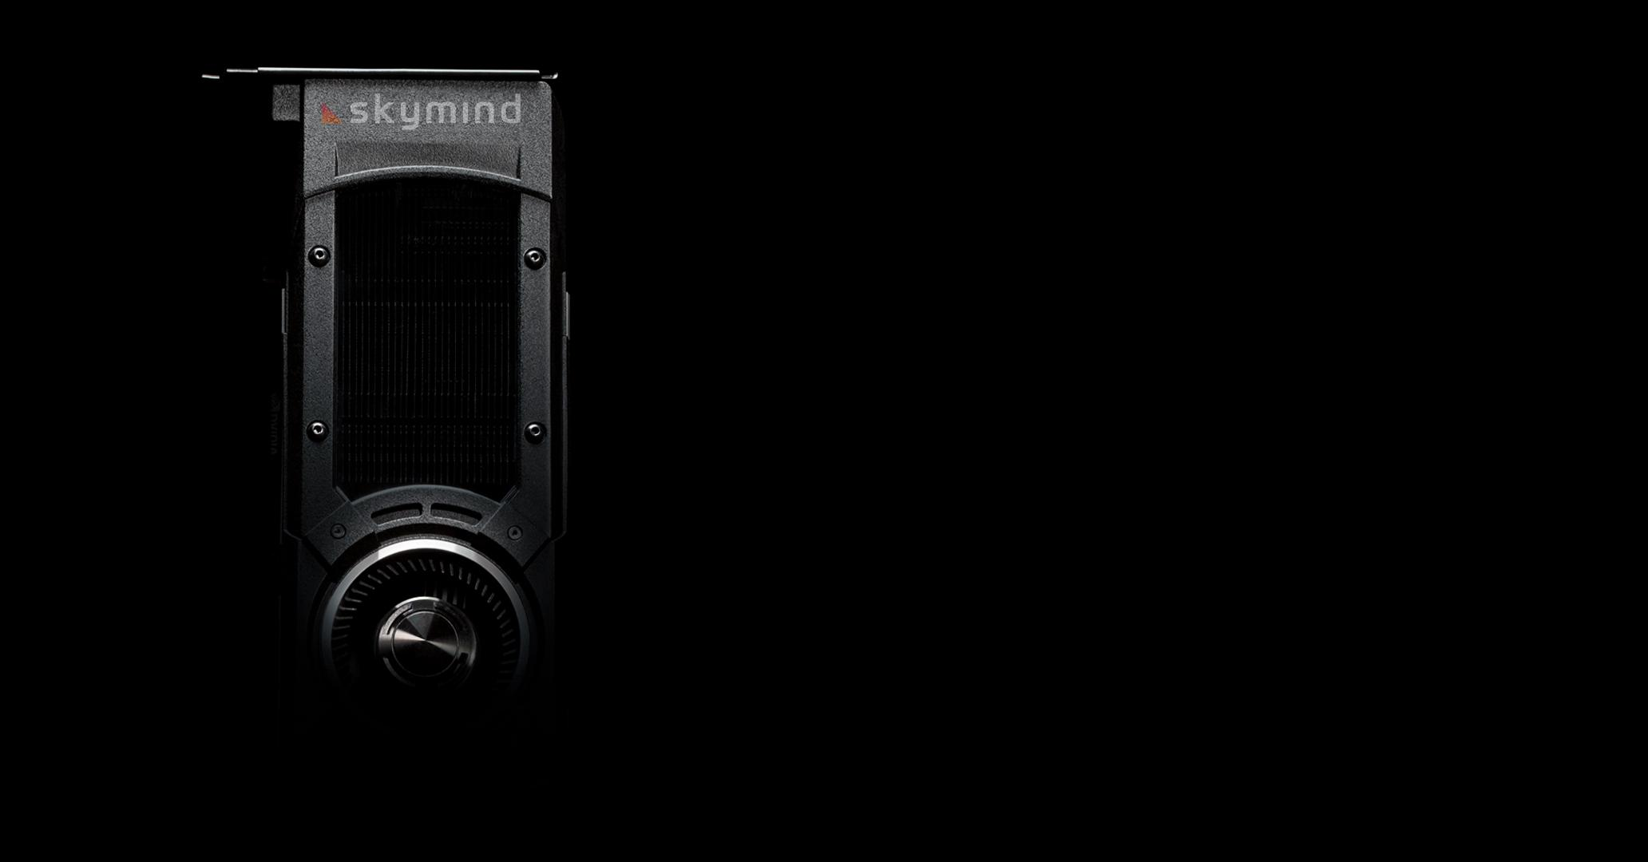

Deep Learning with GPUs in Production
AI By the Bay 2017
DEEP LEARNING WITH GPUS IN PRODUCTION
A.I. BY THE BAY 2016

Slide 4
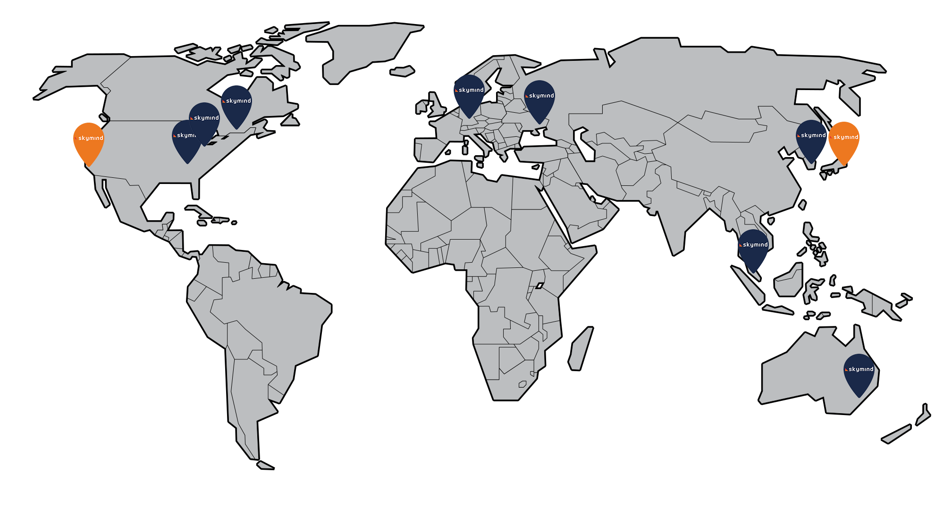

| WHO WE ARE
I LIVE HERE

Slide 5
| DEFINING PRODUCTION
“Startup production”: Cloud, small scale problems, care more about finding product market fit than optimal solution
“Enterprise Production”: Lots of teams and heads, this is the scale you think about static typing mattering
“Research Production”: Not much care about software engineering, focused on quick results and prototyping to prove ideas

Slide 6
| VARIOUS KINDS OF GPU CLUSTERS
On Prem Research: Typically a small cluster ~4 to 5 nodes, python HPC stack
Cloud Research: AWS/Azure Spin up resources as needed. Typically just 1 machine
On Prem Production: HPC, Video Transcoding, Big Data Hybrid (Mesos,YARN,..)
Self Driving Cars
Google/FB/Baidu scale ←- You don’t have this

Slide 7
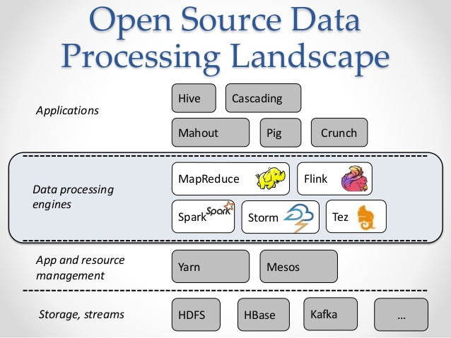
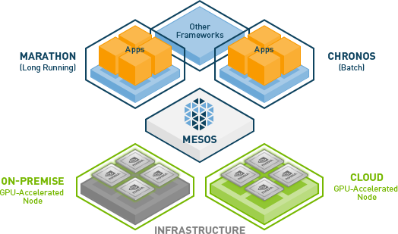
| BIG DATA HYBRID CLUSTER
SPARK / FLINK
Credit: NVIDIA
Credit: Data Artisans: http://www.nextplatform.com/2015/02/22/flink-sparks-next-wave-of-distributed-data-processing/

Slide 8
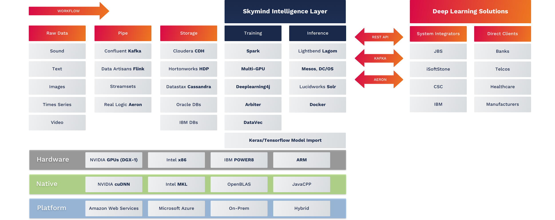
| DEEPLEARNING4J (DL4J)

Slide 9
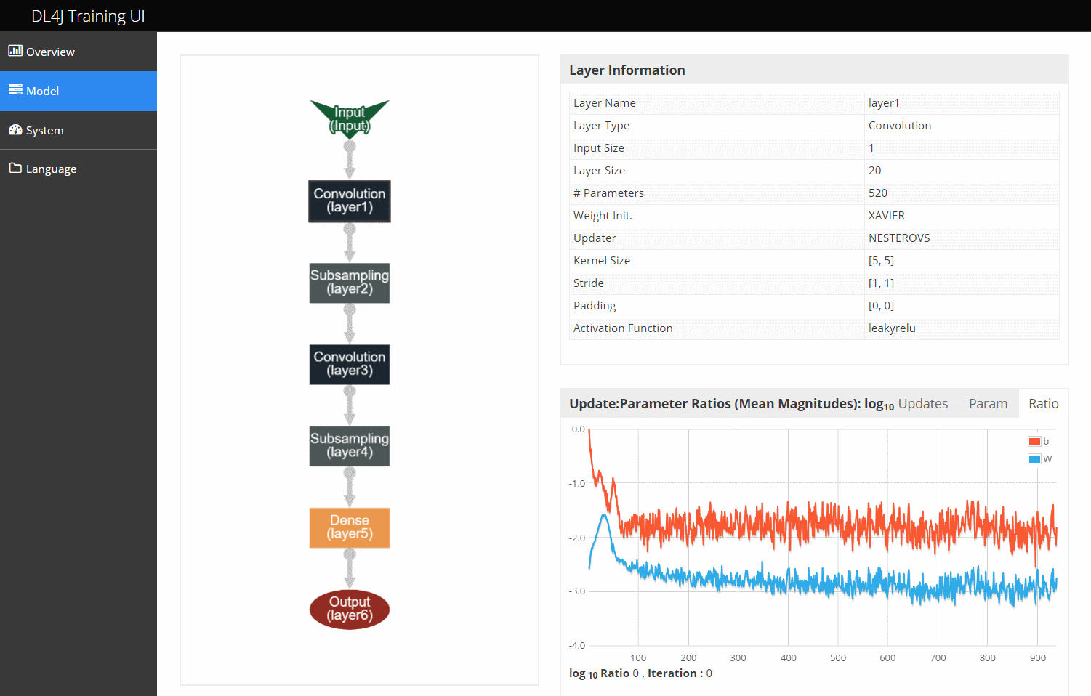
| TRAINING UI

Slide 10















| INFERENCE
WEB APPLICATION
DROPWIZARD
DATA SOURCE
DATA SPOUT
SKIL:
TRAINED MODEL
Logs
VECTORIZATION
IoT
RDBMS
MODEL
MODEL
GPUs
CUDA
CPUs
MKL

Slide 11

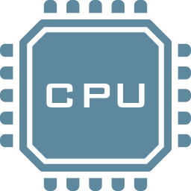

| PROBLEM TO THINK ABOUT JOBS ON GPU CLUSTER
Memory management
Throughput (Jobs are more than matrix math!)
Resource provisioning: number of gpus, cpus, RAM
GPU allocation per job
Runtime (Python <-> Java is expensive and defeats the point of GPUs)

Slide 12
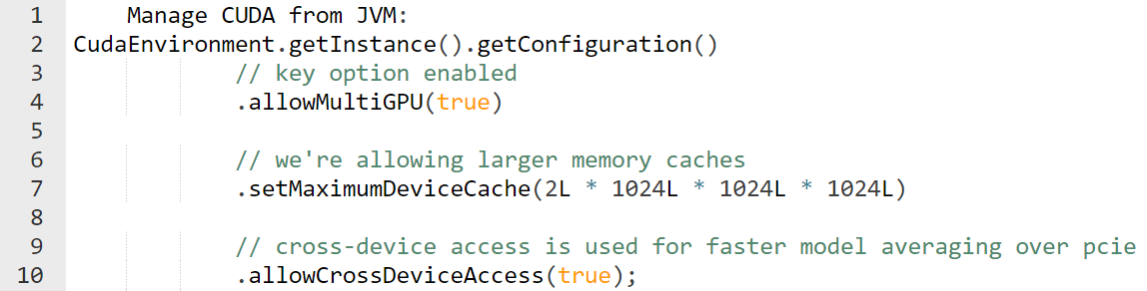
| KEY FOR BIG DATA CLUSTERS
(HOW WE DO IT: OWN THE STACK)
Javacpp for memory management
We have our own GC for CUDA and CUDNN as well (JIT collection on gpu by tracking references via JVM)
We track buffers allocated transparently via nd4j
If on cluster Run everything as spark (soon flink!) job
(In alpha: Run parameter server!)

Slide 13
| WORKFLOW FOR DATA SCIENTISTS
Import via keras (with explicit transfer learning api!)
Use keras as front end backed by JVM stack (1 runtime not 2 to deal with and debug: being python and java)
Run training on spark or local via ParallelWrapper (parameter averaging/multi gpu for single node) while using training UI

Slide 14
| WORKFLOW FOR DATA ENGINEERS AND
MICROSERVICES DEVELOPERS
Define pipeline via datavec (same pipeline can be used for production and training)
Optionally import model from data scientist
Create model with scalnet or deeplearning4j in java
Deploy with spring boot/lagom/play (android also supported)
Training and inference can run on gpu with nd4j (no code changes)
Flexibility allows for scenarios like kafka -> tensorrt

Slide 15

| RECENT CASE STUDY: NASA JPL
https://github.com/USCDataScience/dl4j-kerasimport-examples
Apache Tika and other ETL tools written for JVM (pretty common)
Data Science team using keras in python
Hassle integrating, switched to dl4j after model import came out
Reason: Embeddable (not a gigantic runtime with lots of dependencies)

Slide 16
help@skymind.io

